Slide 1
Case Study on Online Examination Portal

Slide 2
INTRODUCTION
Project Goal: To automate the traditional offline examination process and create a streamlined, error-free digital recruitment and assessment environment.
Student Benefits: Provides a centralized platform where students can view assigned exams, participate in real-time assessments, and receive instant performance feedback.
Institutional Benefits: Helps teachers and organizations identify eligible candidates based on specific criteria and automated scoring logic.
Core Structure: The system is built around four primary pillars:
Admin Module: For question and exam management.
Student Module: For exam participation and dashboard access.
Question Bank: A secure repository of categorized questions.
Result Tracking: Real-time persistence of performance data.:

Slide 3
ABSTRACT
Project Objective: To develop a robust, web-based Online Examination Portal that centralizes and automates the entire lifecycle of student assessments.
Core Logic: The system replaces manual paper-based testing with a digital engine that handles question management, real-time submission, and automated grading.
Operational Efficiency: * Admin Console: Enables full control over the question bank (CRUD operations).
Student Interface: Provides a dynamic environment to attempt exams and receive instant results.
Frameworks & Tools: * Backend: Developed using Spring Boot and Spring Web for high-performance request handling.
Frontend: Built with Thymeleaf for server-side rendering of dynamic HTML content.
Database: Integrated with MySQL via Spring Data JPA for reliable data persistence.
Key Outcome: Reduces human error in grading, provides students with immediate performance feedback, and maintains a secure record of all examination data.

Slide 4
What we are going to build: Client Requirement
Centralized Exam Management: The client requires a system where an Admin can manage a repository of questions and monitor the overall performance of all students.
Student Assessment Interface: A platform for Students to log in, view available questions, and submit their responses through a digital form.
Automated Scoring Logic: The system must automatically calculate the total score by comparing student input with the correct answers stored in the database.
Result Persistence:
Capturing student identity (Email).
Recording the final score and total questions attempted.
Storing a timestamp of the submission.
Dashboard Reporting: A requirement for a dedicated Teacher View to display results in a tabular format, including data like Student Name, Score, and Date.
Question Bank Control: Full CRUD (Create, Read, Update, Delete) capabilities for the Admin to update exam content without manual SQL intervention.

Slide 5
What we are going to build: Some technical terms.
Spring Boot: The core Java-based framework used to create a stand-alone, production-grade application with minimal configuration.
Spring Web (MVC): A module used to handle HTTP requests and build the web layer. It follows the Model-View-Controller design pattern to separate data, logic, and UI.
Thymeleaf: A modern server-side Java template engine used to render dynamic HTML pages (like your exam and dashboard views) based on backend data.
Spring Data JPA: A part of the Spring family that makes it easy to implement Java Persistence API (JPA) to manage relational data using Java objects.
Hibernate: The Object-Relational Mapping (ORM) tool that works under JPA to map your Java classes (Question, Result) to MySQL tables.
Maven: The project management and comprehension tool used for dependency management (handling all your JAR files) and build automation.
Dependency Injection (DI): A design pattern used by Spring to automatically manage the lifecycle of objects (like @Autowired repositories), making the code modular and testable.

Slide 6
What are the technologies and tools we are going use?
Programming Language: Java (JDK 8 or higher) – The core language for backend logic and data processing.
Framework: Spring Boot – The foundation that simplifies configuration and runs our application.
Web Layer: Spring Web (MVC) – Handles the navigation and communication between your browser and the server.
Template Engine: Thymeleaf – This is our "Frontend." It replaces Postman by providing the actual HTML forms used to add questions and submit exams.
User Interface: HTML5 & Bootstrap – Used within Thymeleaf templates to make the exam portal look professional and responsive.
Database: MySQL – The permanent storage for your Question Bank and Student Results.
ORM Tool: Spring Data JPA (Hibernate) – Connects your Java code to MySQL so you don't have to write manual SQL.
Build Tool: Maven – Manages all project dependencies and builds the executable JAR file.
Development Tool (IDE): Spring Tool Suite (STS) – The environment where the code was written and executed.

Slide 7
SYSTEM REQUIREMENTS
Software Requirements:
Back End: Developed using Spring Boot, Spring Web, and Spring Data JPA (Hibernate).
Front End: Dynamic UI rendered using Thymeleaf templates and Bootstrap.
Database Server: MySQL Server 8.0 for secure data persistence of questions and results.
Web Server: Embedded Apache Tomcat (built into Spring Boot).
IDE: Spring Tool Suite (STS) or VS Code for development.
Browser: Google Chrome (or any modern browser) used for testing the exam interface and admin dashboard.
Unit Testing: JUnit framework for testing repository and service layer logic.
Hardware Requirements (Minimum):
Processor: Dual-core 2.0 GHz or higher.
RAM: 4 GB (8 GB recommended for running IDE and Database simultaneously).
Storage: 500 MB of free space for project files and database storage.

Slide 8
PROJECT MODULES
Admin Module
Manage the question bank (CRUD operations).
Monitor all student exam results.
Student Module
Participate in real-time online exams.
View individual performance scores.
Question Bank Module
Secure storage of all objective questions.
Organization by topic and difficulty.
Result Module
Automated scoring upon submission.
Record student email, score, and timestamp.

Slide 9
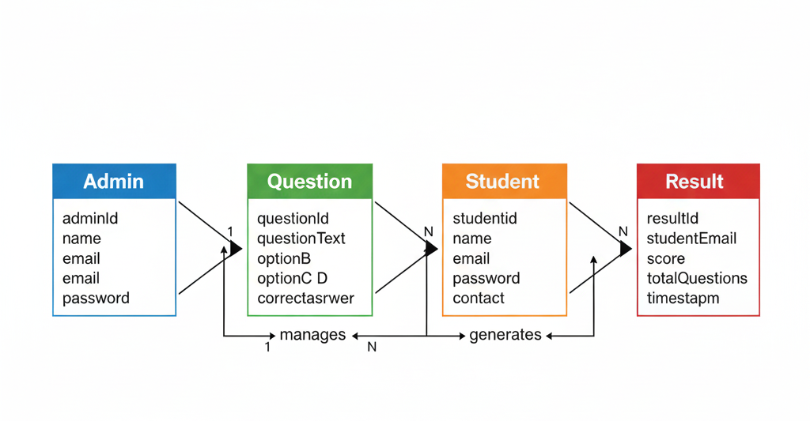
ER DIAGRAM

Slide 10
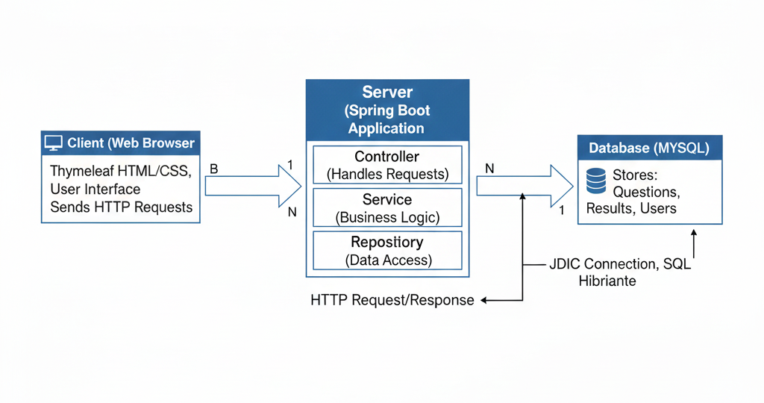
Client – Server Architecture

Slide 11
ADMIN MODULE
User Management & Control:
Add New Users: Admin can register new Students and Teachers by providing their unique Email and Password.
Authorization Access: The system automatically grants specific access levels based on the user type created.
User Maintenance:
Remove Records: Admin has the authority to delete Student or Teacher profiles from the system.
User Lists: Provides a clear view of all registered Teachers and Students organized in their respective columns for easy tracking.
Administrative Oversight:
Data Integrity: Ensures all user credentials and roles are securely stored in the MySQL database via Spring Data JPA.
Centralized Dashboard: A unified interface for monitoring every entity within the portal.

Slide 12
TEACHER MODULE
Question Bank Authority:
Manage Questions: Teachers have the primary responsibility to Create, Update, and Delete questions in the database.
Define Content: Set question text, multiple-choice options, and mark the correct answer for automated grading.
Assessment Oversight:
View Results: Teachers can access a detailed list of all student scores and performance metrics.
Result Sorting: Ability to view which students have completed the exam and their final marks in real-time.
System Interaction:
Secure Login: Teachers use the credentials provided by the Admin to access their specific dashboard.
Thymeleaf Interface: All actions are performed through dynamic web forms that communicate directly with the Spring Boot backend.

Slide 13
STUDENT MODULE
Secure Authentication:
Students log in using the unique Email and Password credentials generated and authorized by the Admin.
Exam Participation:
View Exams: Access a list of available assessments assigned by the teacher.
Real-time Interface: Interact with a dynamic Thymeleaf-based exam page to select answers for multiple-choice questions.
Submission & Evaluation:
Instant Submission: Submit the completed exam with a single click, triggering the backend scoring logic.
Automatic Grading: The system compares student answers against the database records to calculate the final score instantly.
Performance Tracking:
Personal Dashboard: Students can view their own result history, including total marks and the exact time of submission.

Slide 14
DATA DICTIONARY

Slide 15
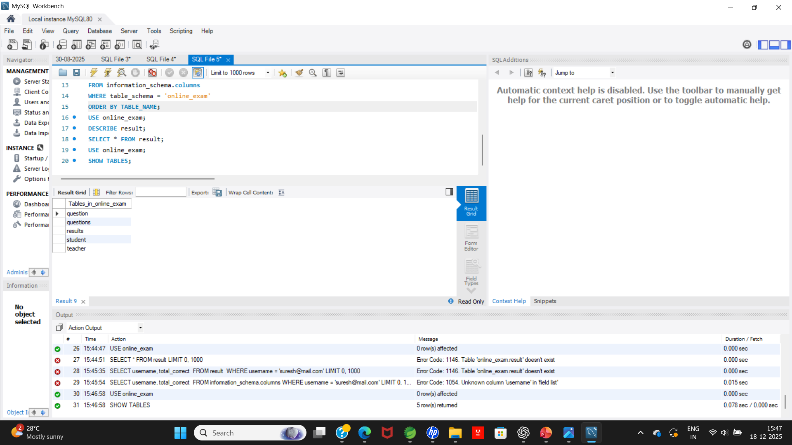
TABLE OF CONTENTS

Slide 16
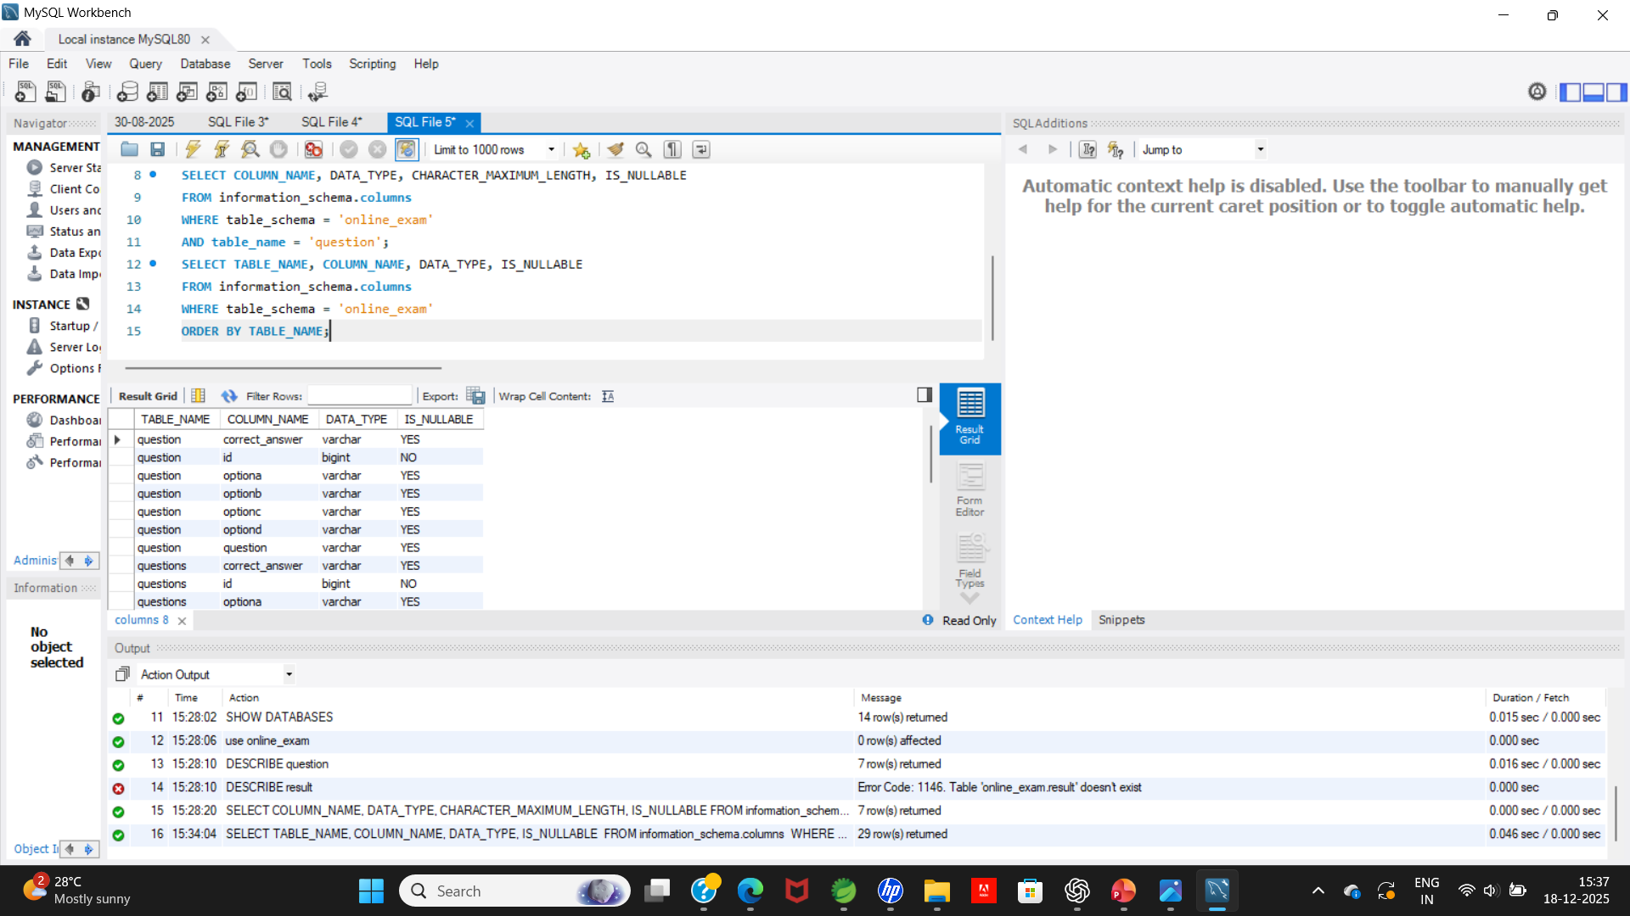
QUESTION TABLE

Slide 17
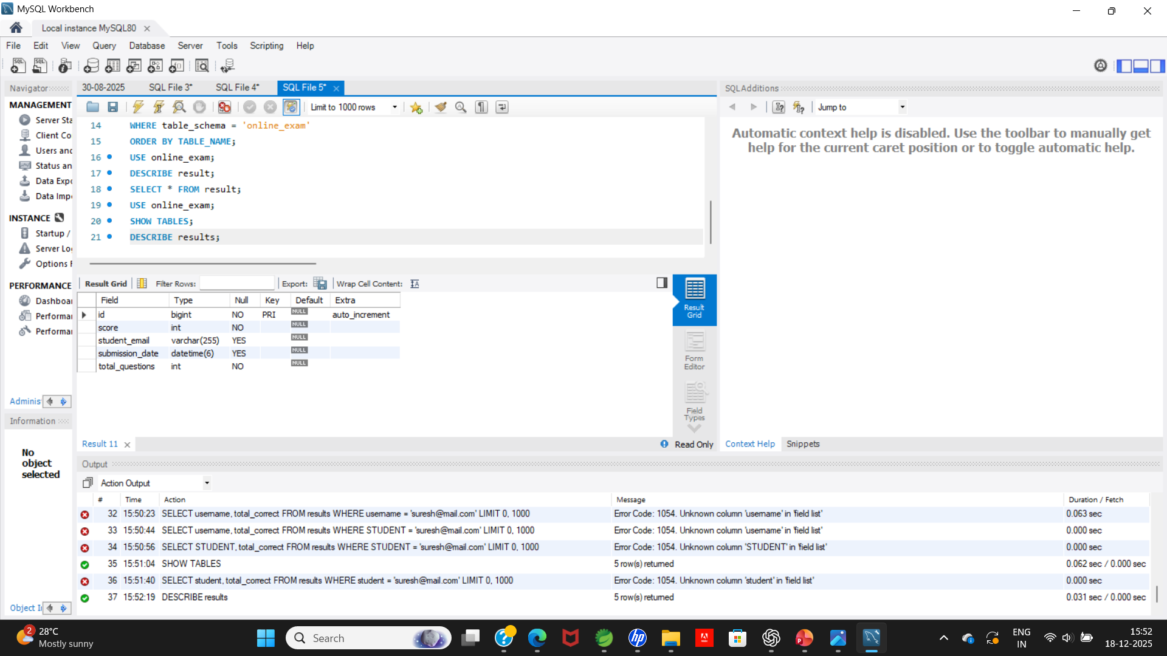
RESULT TABLE

Slide 18
PROJECT OUTPUTS

Slide 19
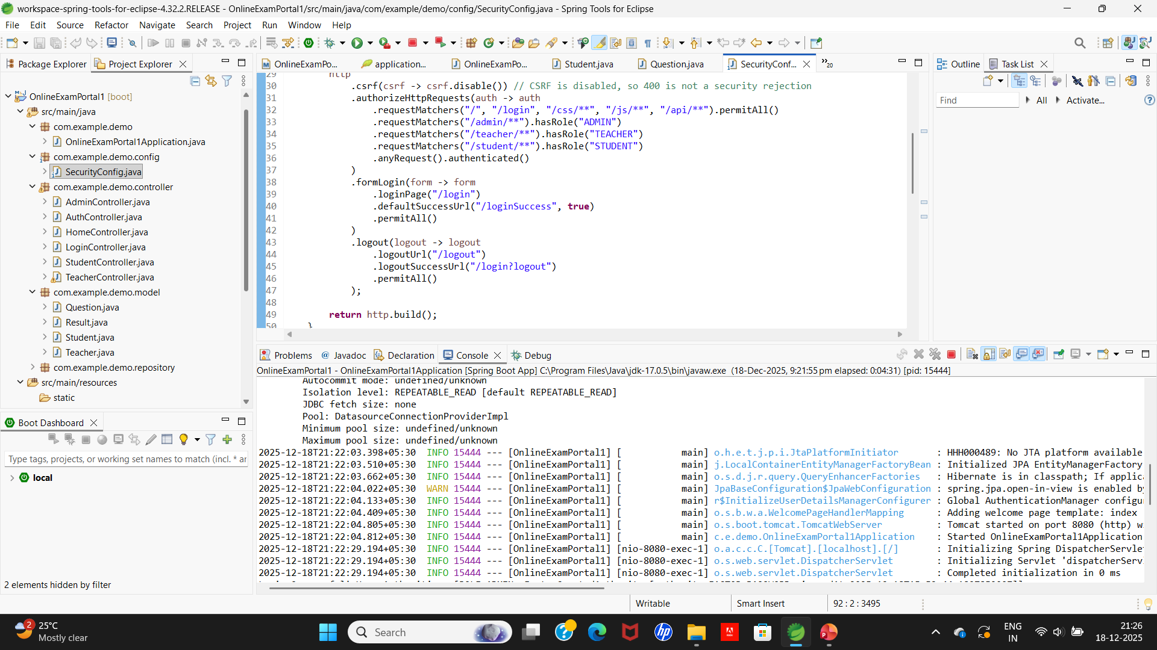
PROJECT EXECUTION

Slide 20
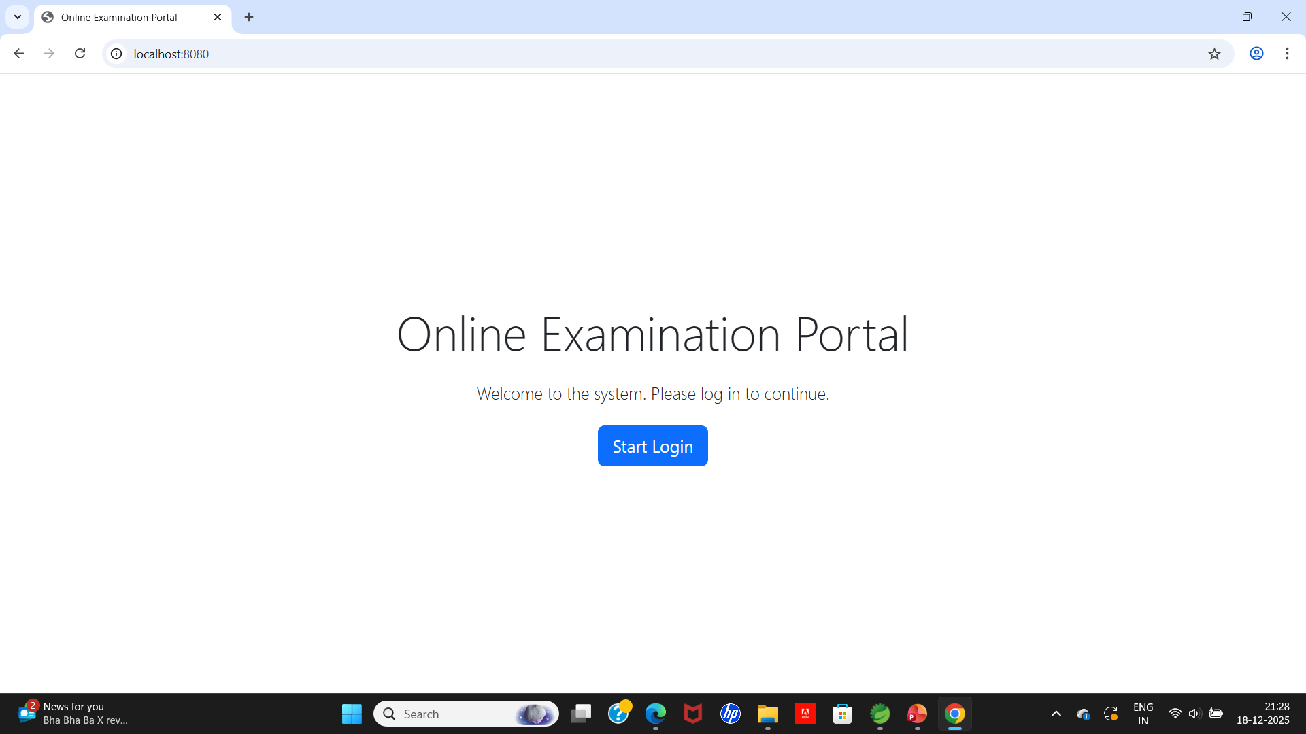
Online Examination Portal

Slide 21
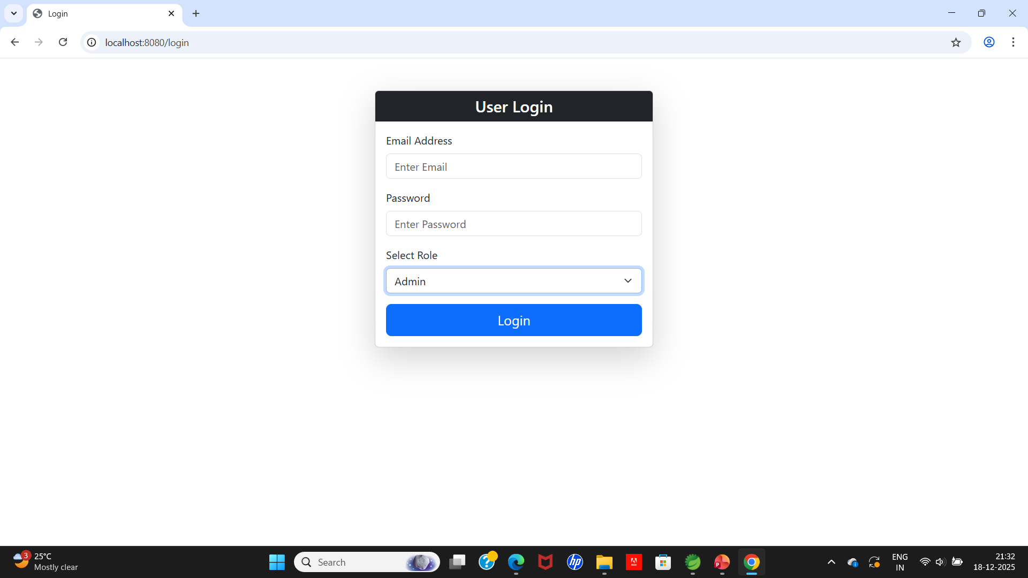
USER LOGIN

Slide 22
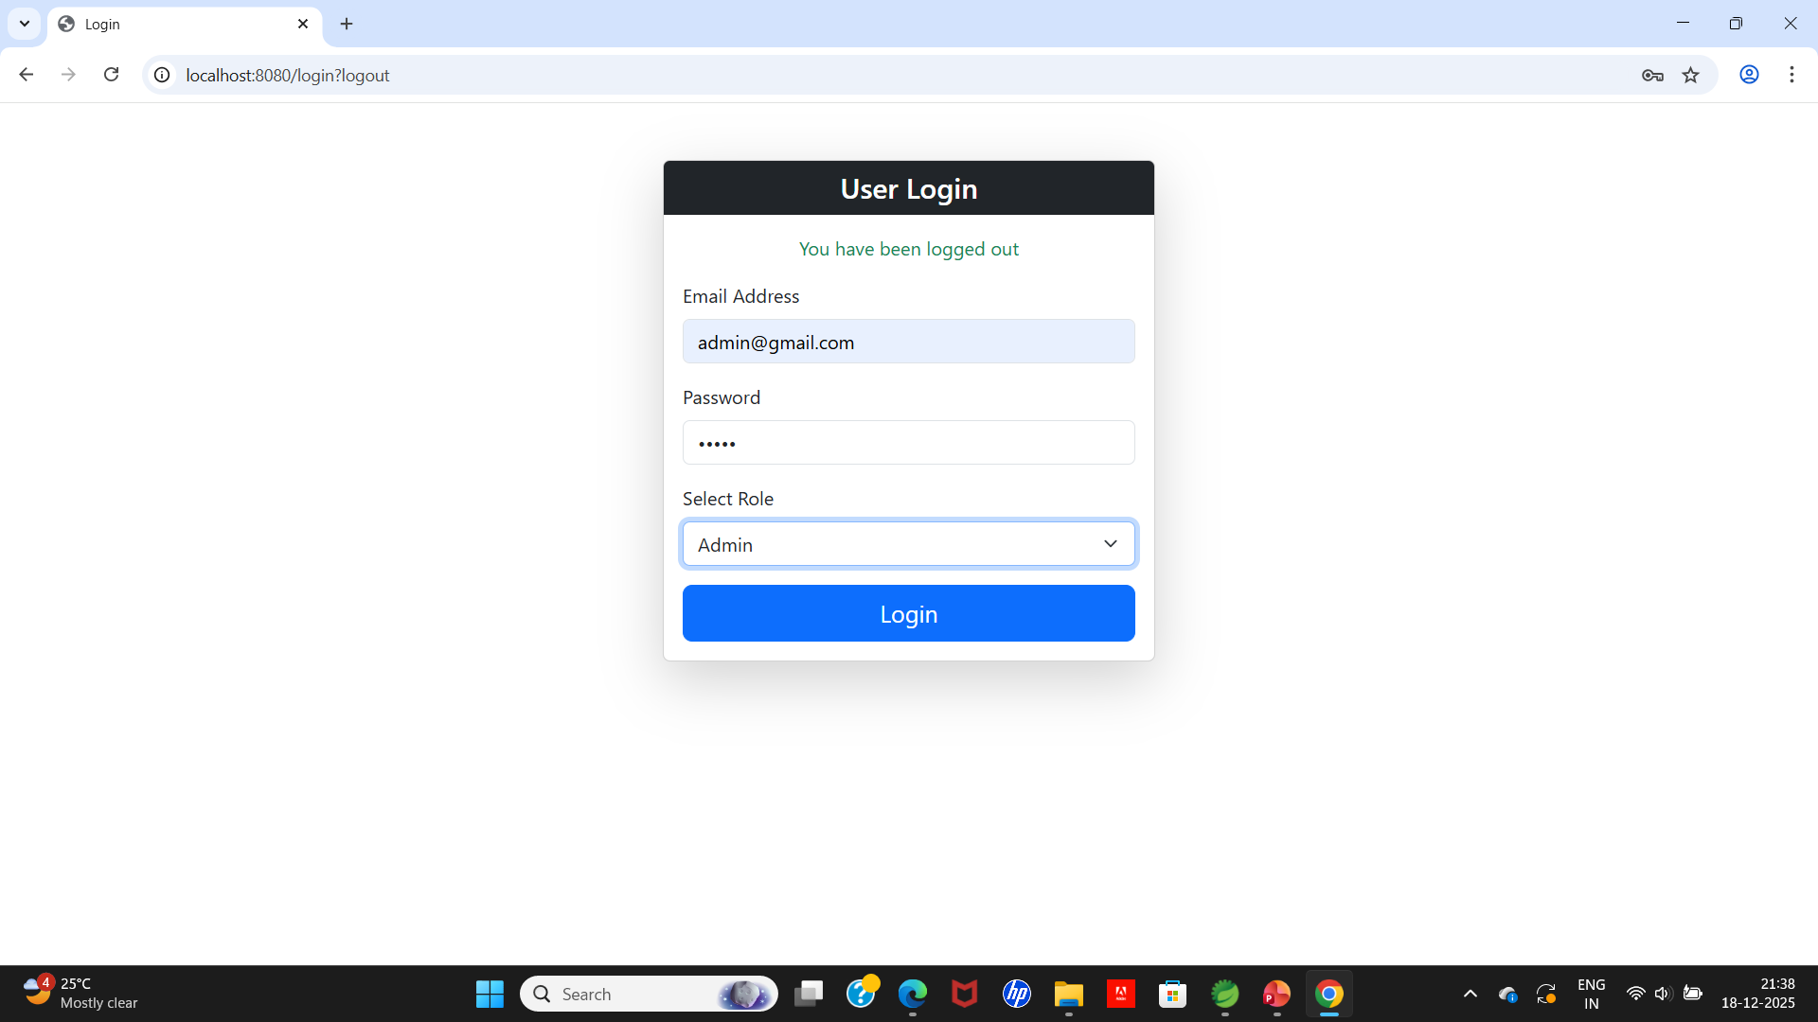
ADMIN LOGIN

Slide 23
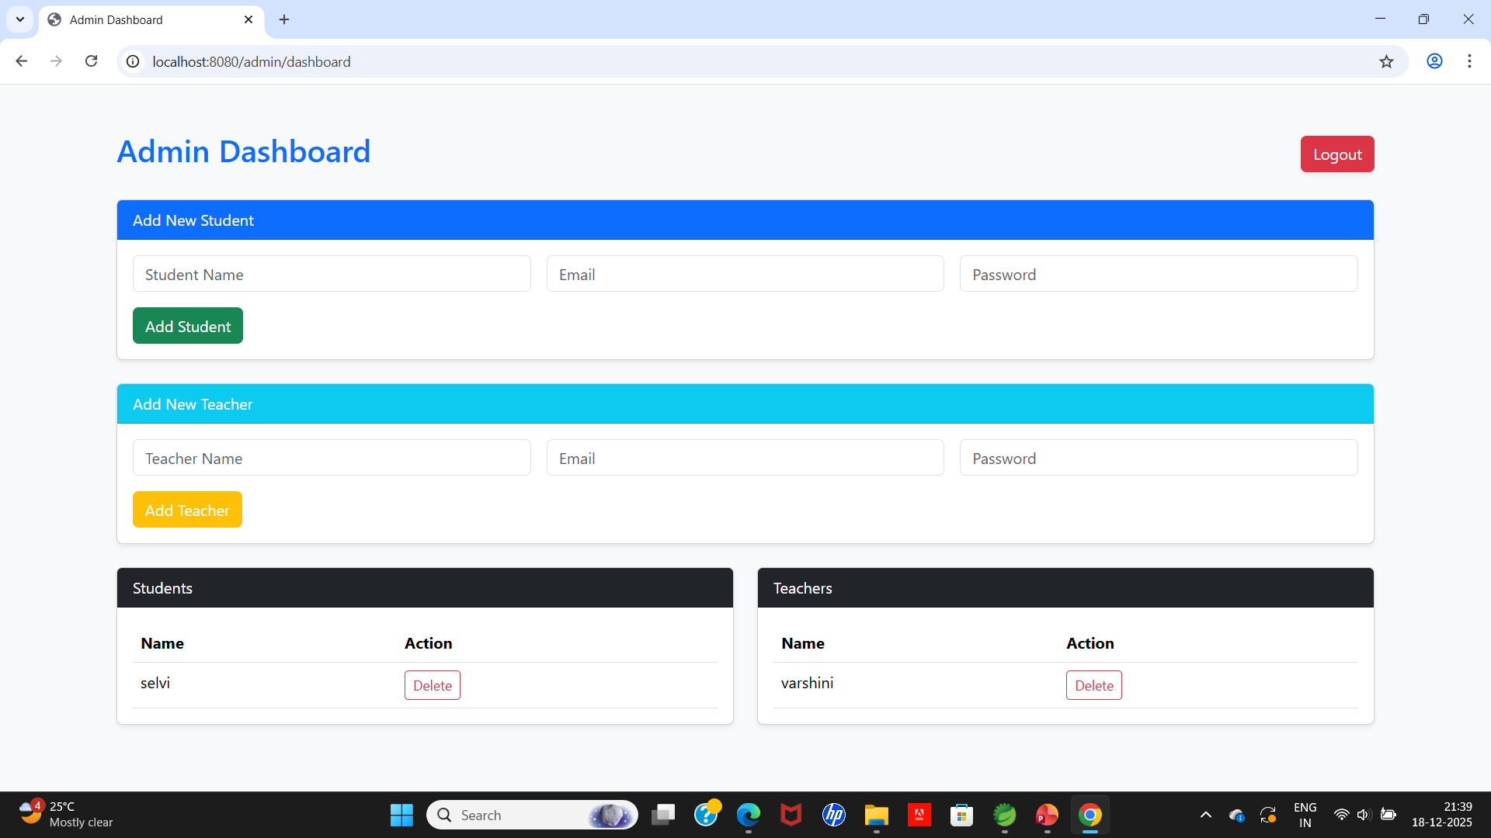
ADMIN DASHBOARD

Slide 24
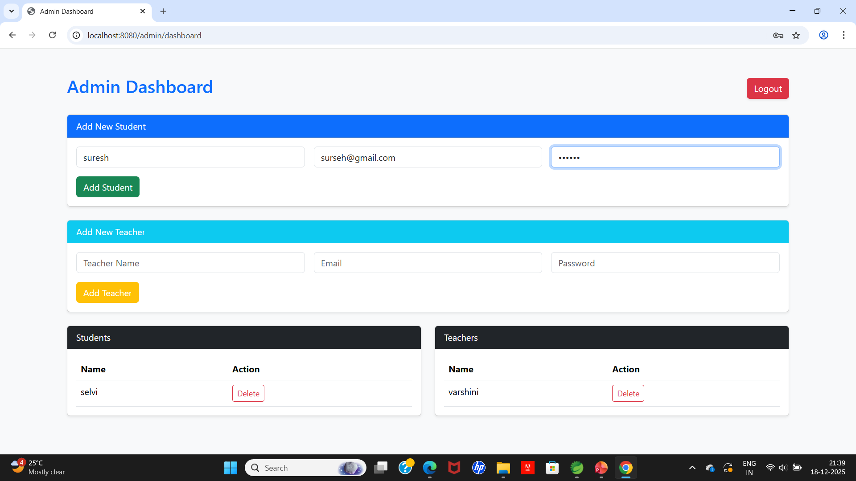
ADDING NEW STUDENT

Slide 25
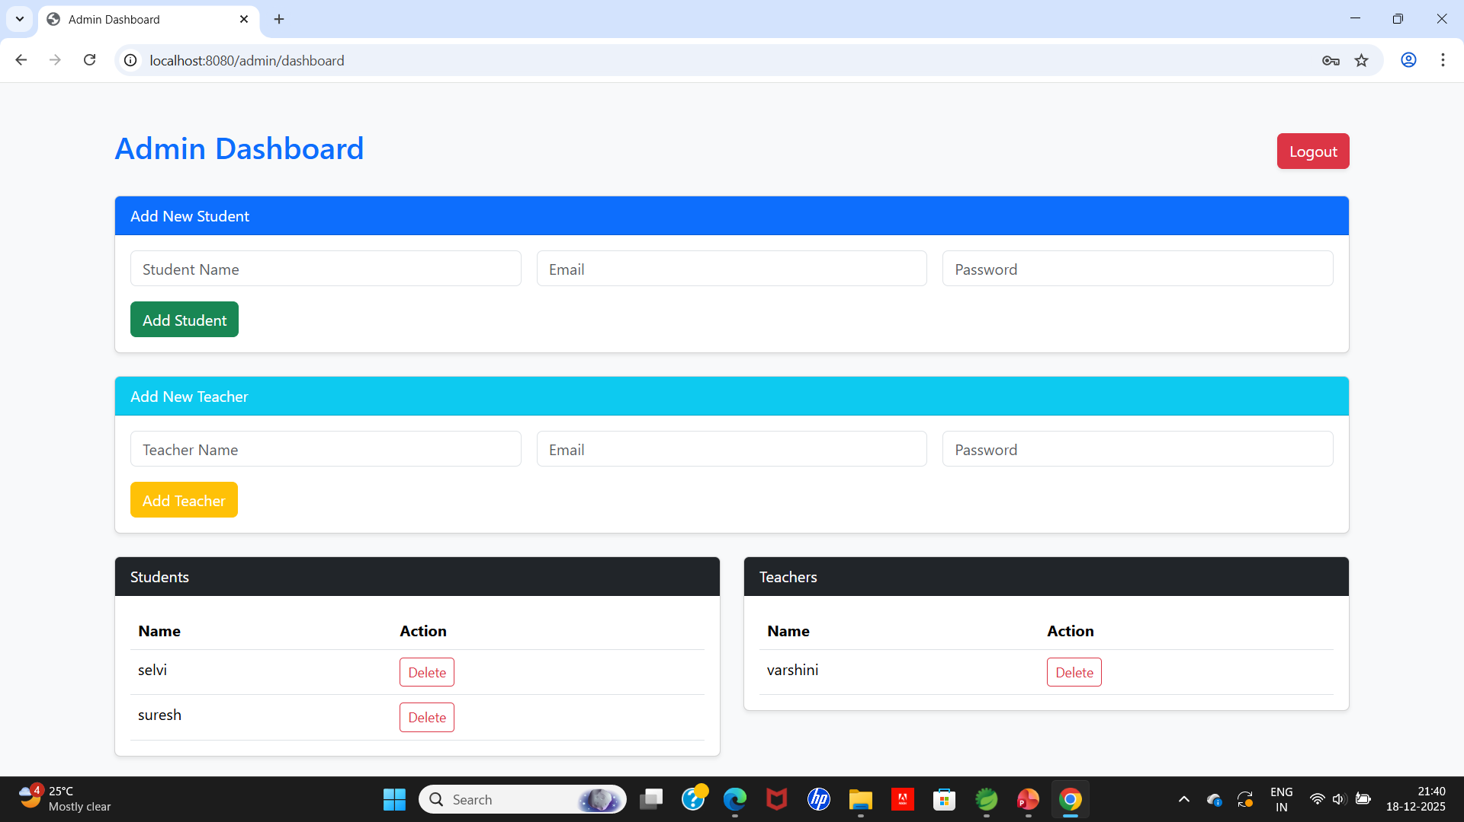
RESULT OF NEW STUDENT

Slide 26
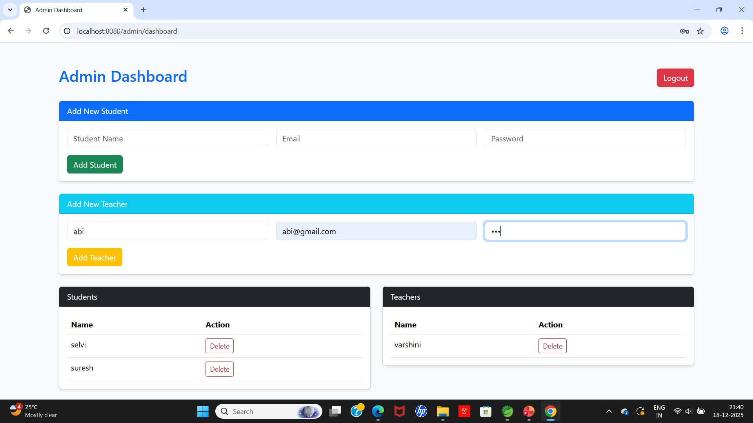
ADDING NEW TEACHER

Slide 27
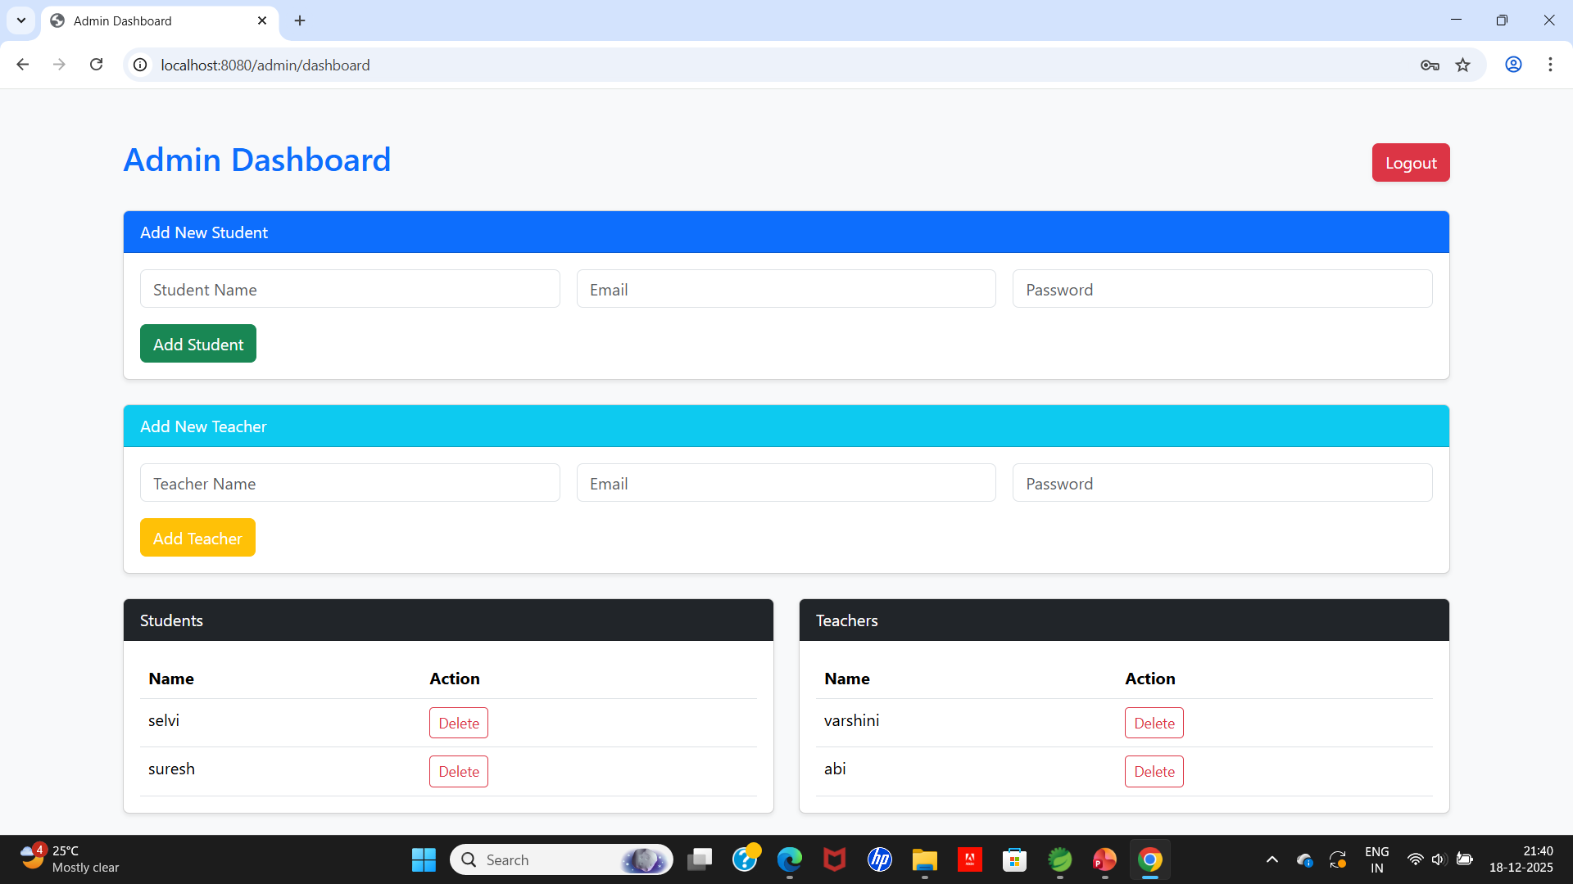
RESULT OF NEW TEACHER

Slide 28

LOGGING IN AS TEACHER

Slide 29
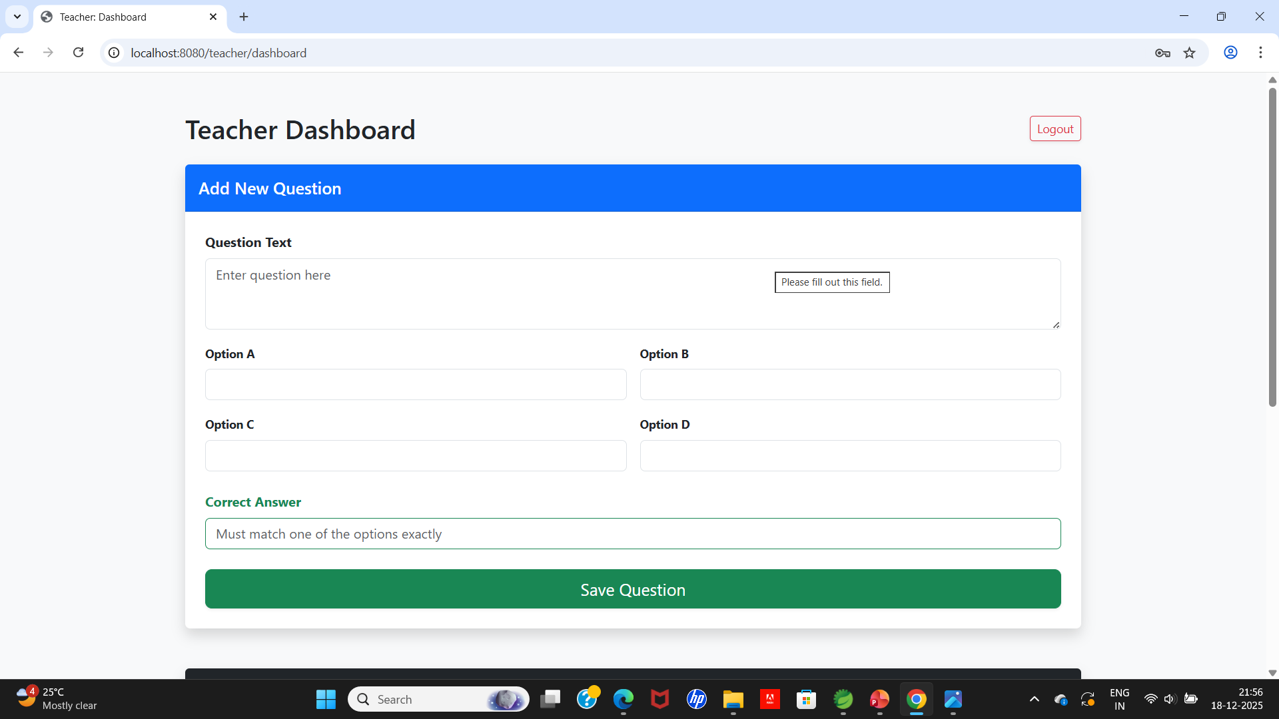
TEACHER DASHBOARD

Slide 30
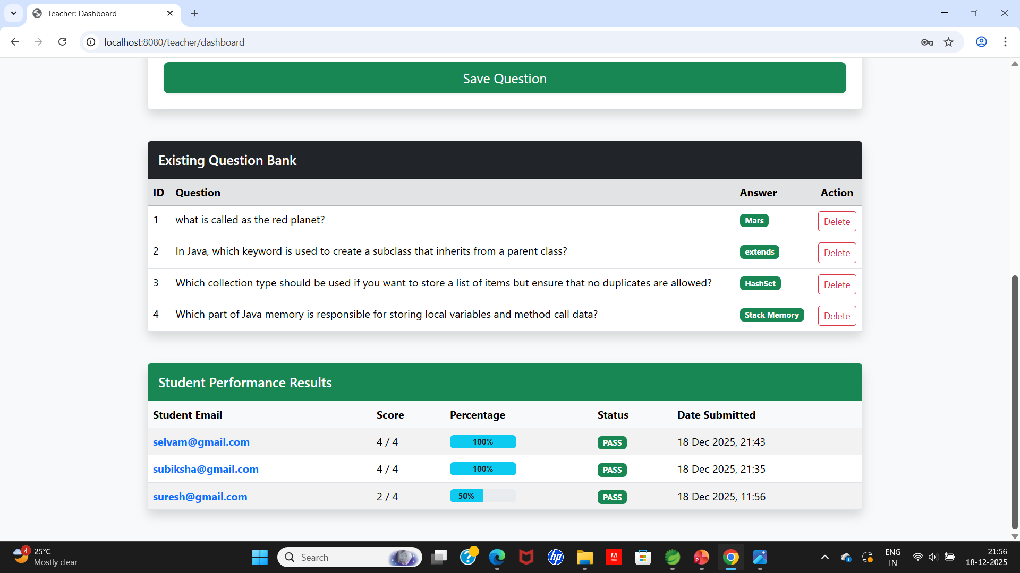
TEACHER DASHBOARD VIEW(SCROLLED DOWN)

Slide 31
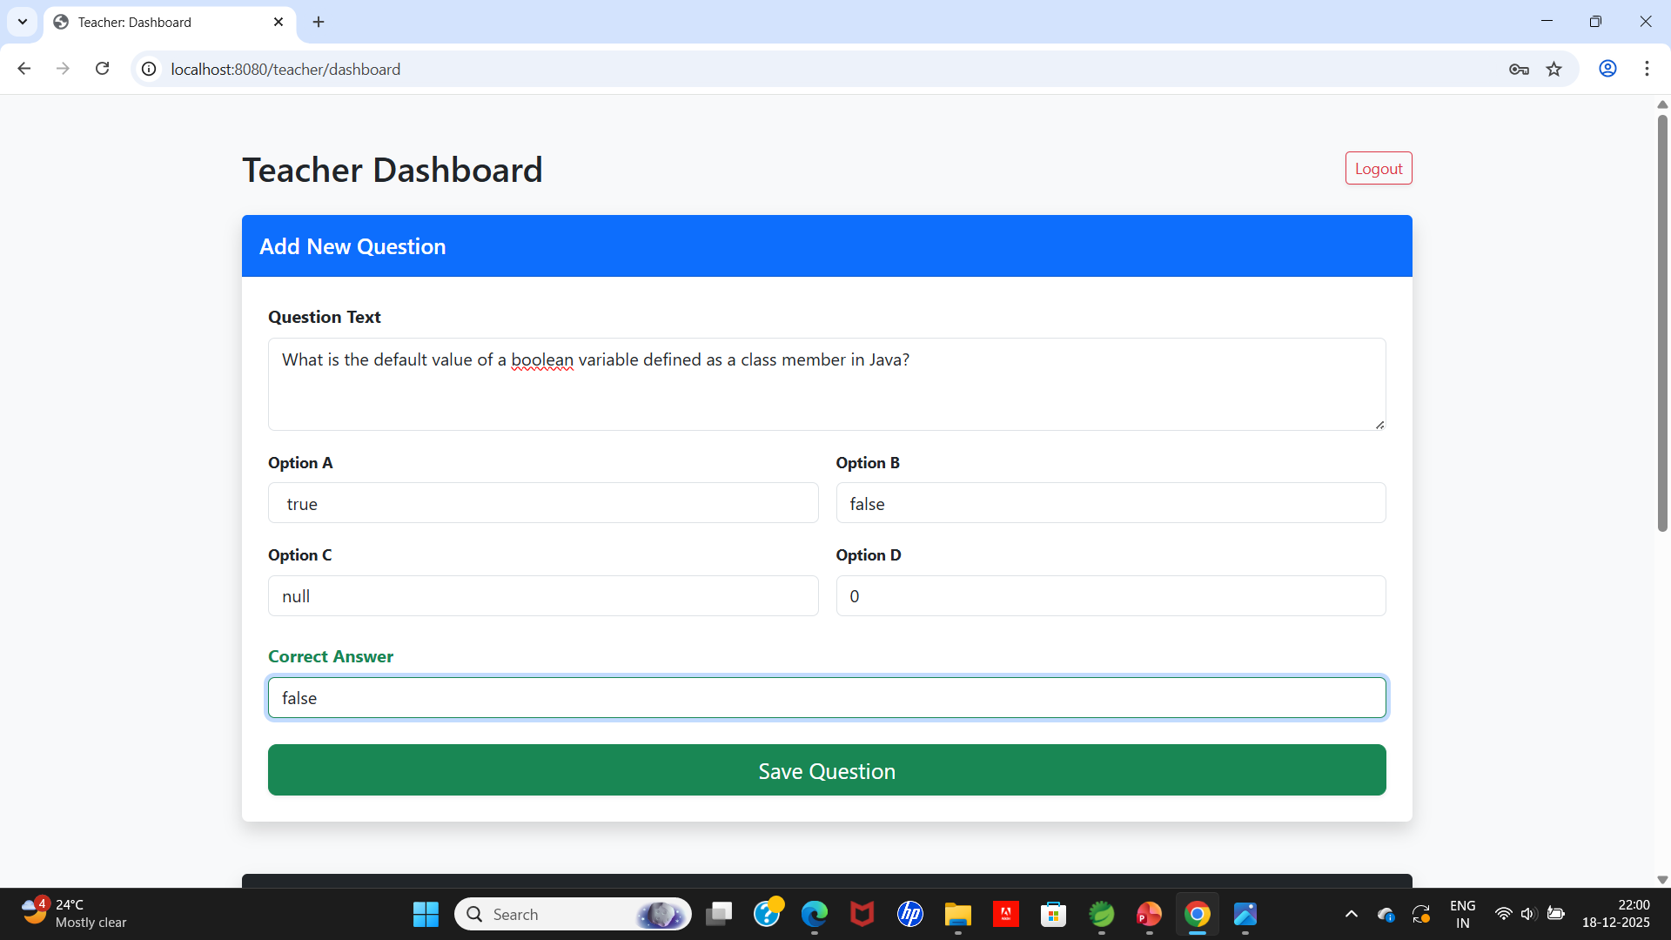
ADDING A NEW QUESTION

Slide 32
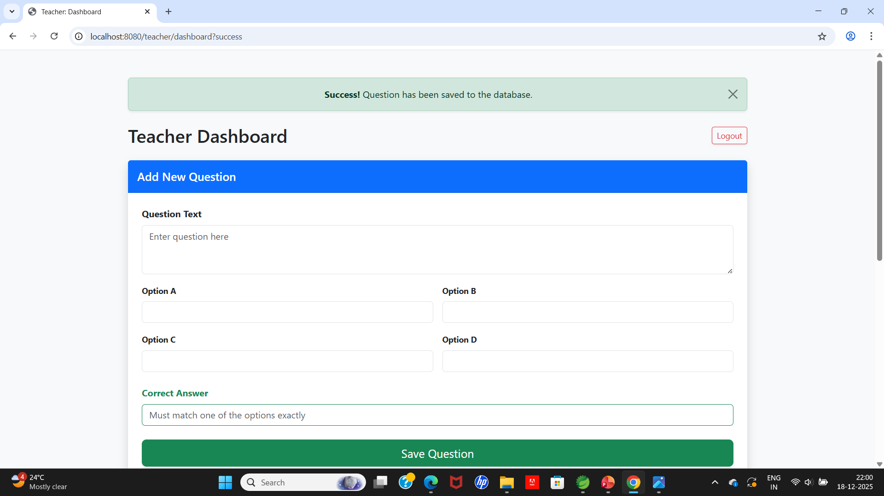
SHOWS SUCCESS MESSAGE AFTER SAVING

Slide 33
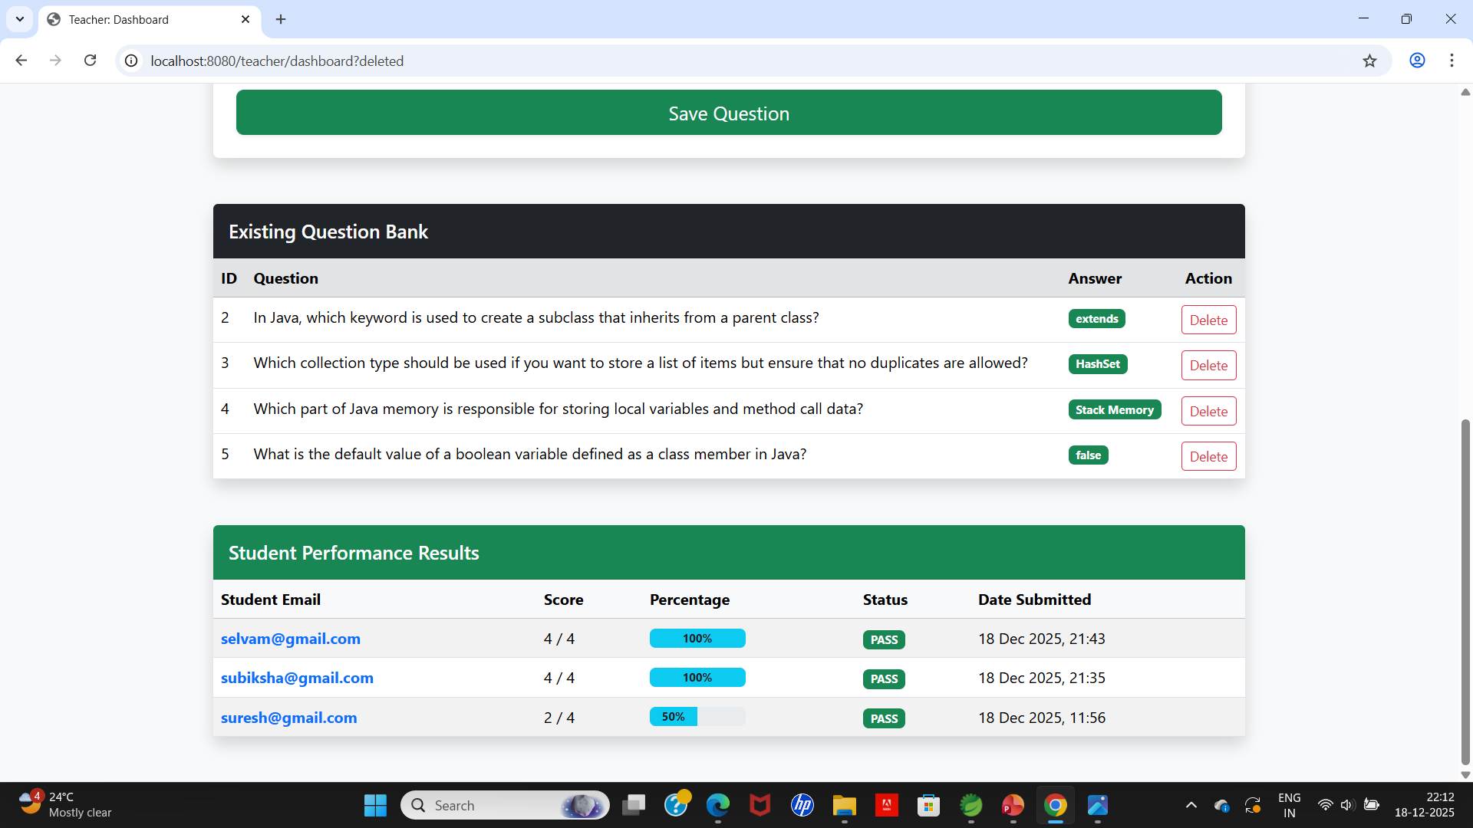
SHOWS EXISTING QUESTIONS AND STUDENT'S PERFORMA

Slide 34

LOGGING IN AS STUDENT

Slide 35
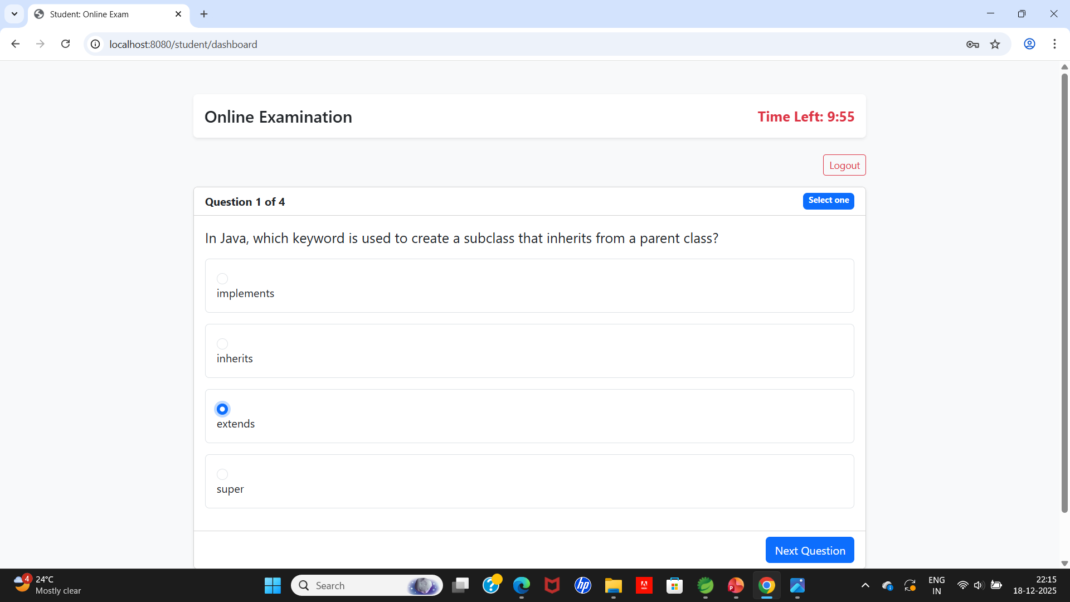
ENTERS INTO EXAM MODE WITH QUESTIONS SET AND TIMER IF SELECTED COULD MOVE TO NEXT QUESTION

Slide 36
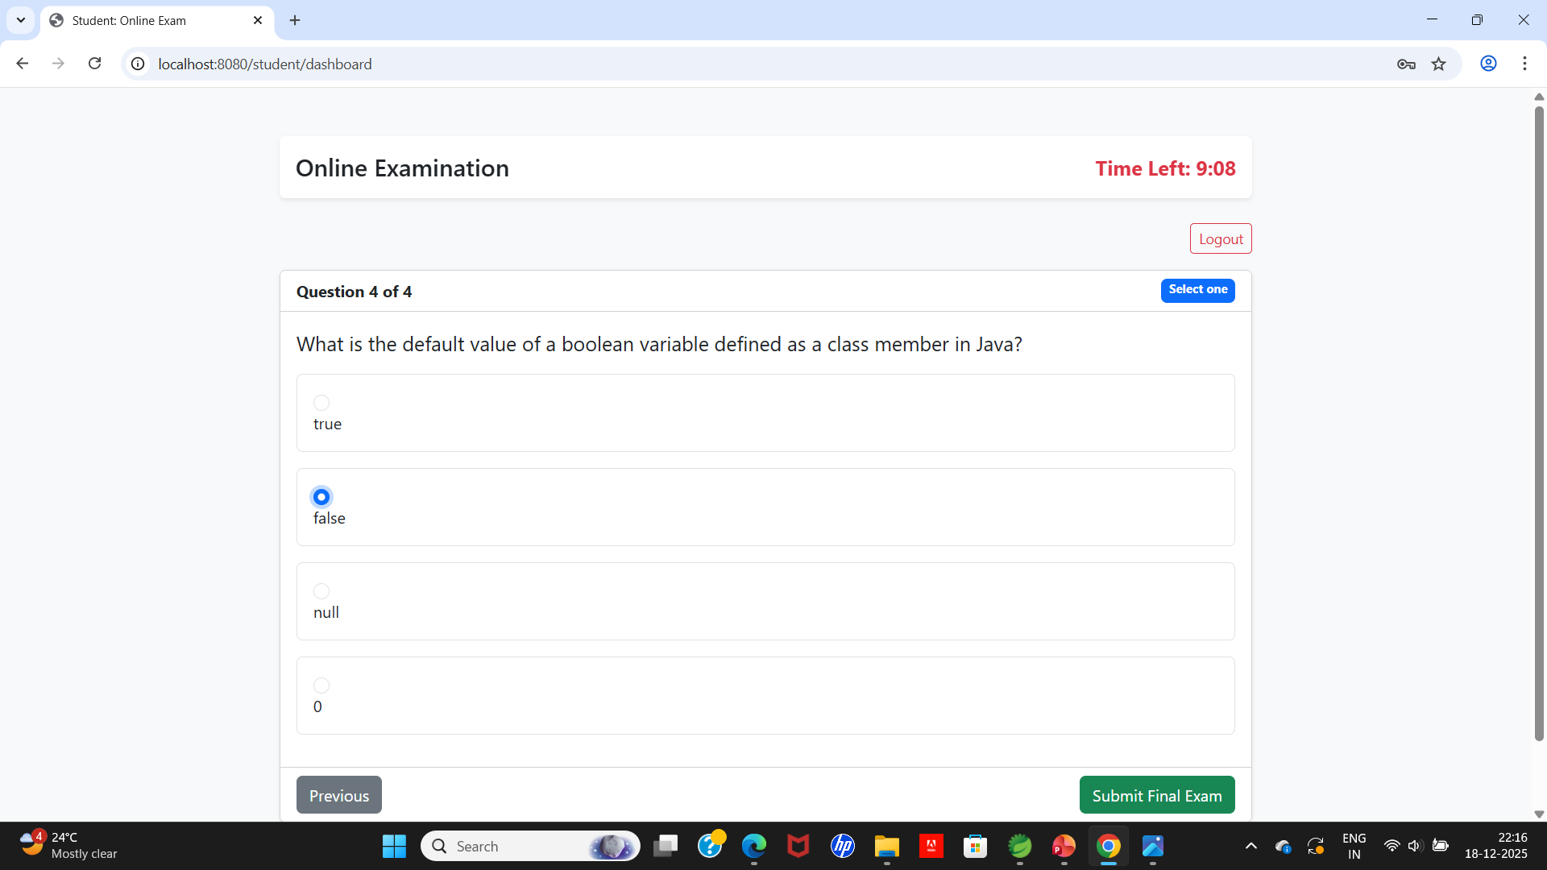
SKIPS TO NEXT ADN REACHES FINAL QUESTION WITH SUBMIT BUTTON OPTION

Slide 37
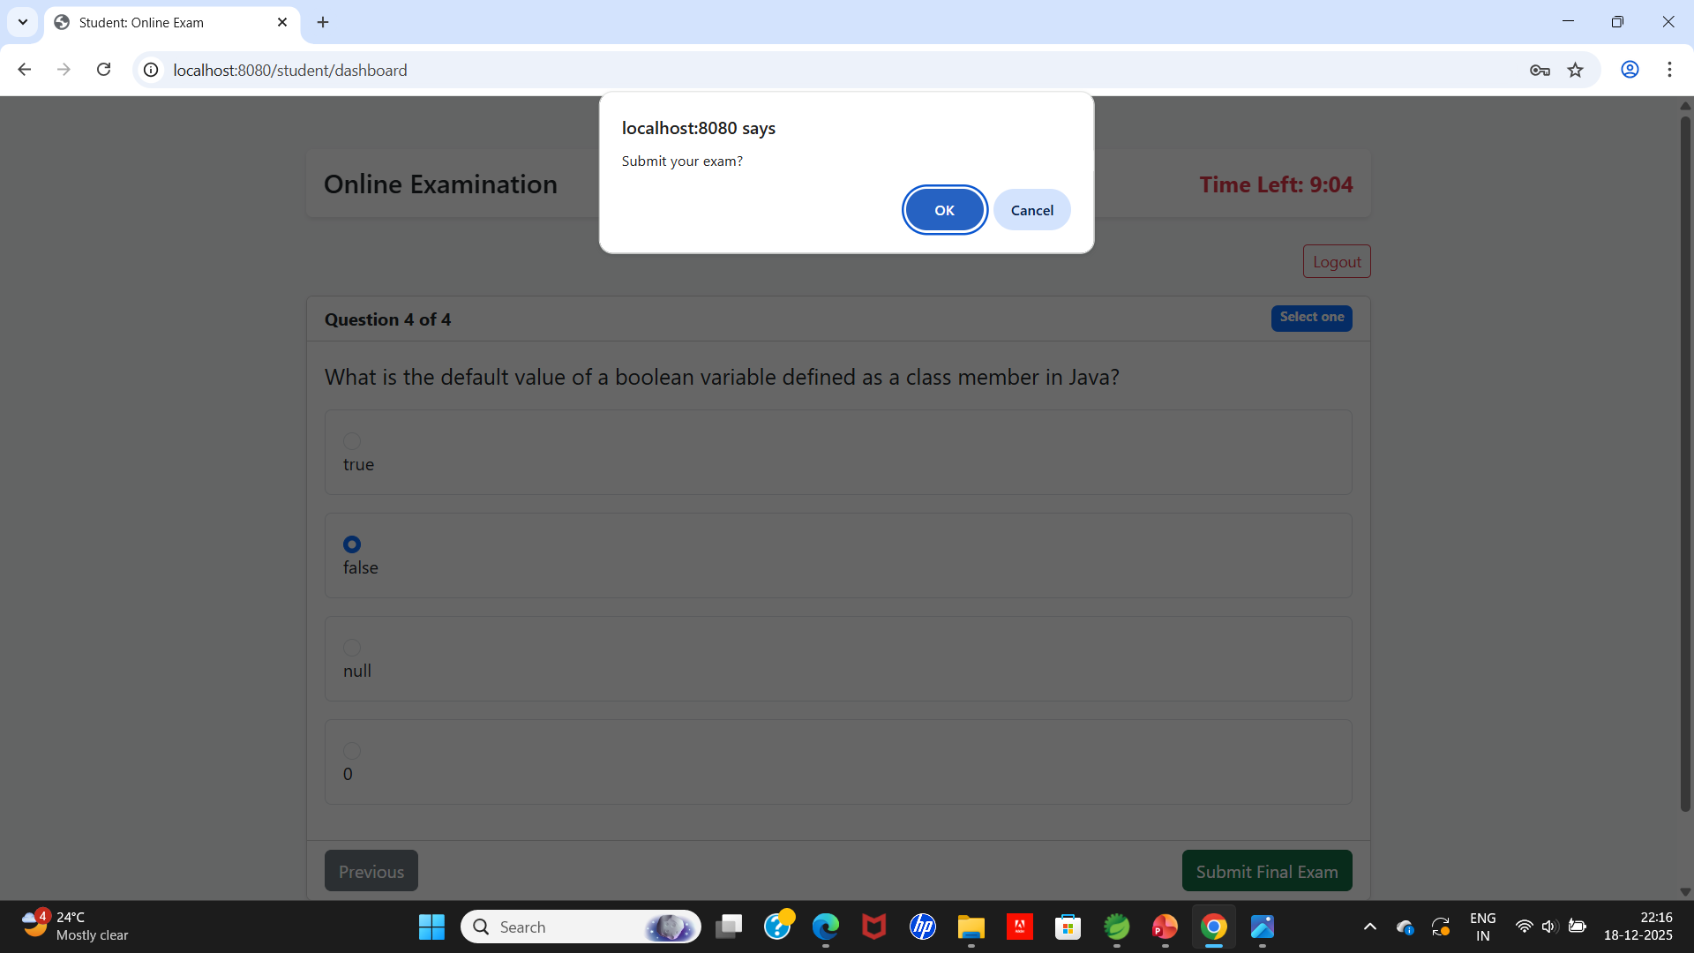
ASKS FOR FINAL CONFORMATION

Slide 38
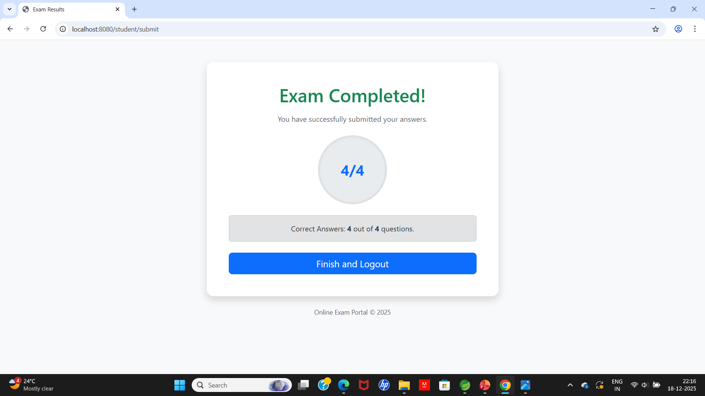
EXAM RESULT

Slide 39
LINKS
GITHUB LINK:Varshini278/Sri-Varshini_43130567
VIDEO LINK: https://drive.google.com/file/d/11psMl-9BuNcnTSbohTy6V_0YhTMI549v/view?usp=sharing

Slide 40
THANK YOU

